Slide 1



Performance & Exploring JS (2)
By Elham Jaffar

Slide 2
ARIA
Accessible Rich Internet Applications
Defines a way to make Web content and Web applications more accessible to people with disabilities.
You can use it by adding a role to element with no semantics like “div” or to modify semantics element like “button”
More Info!

Slide 3
Object

Slide 4
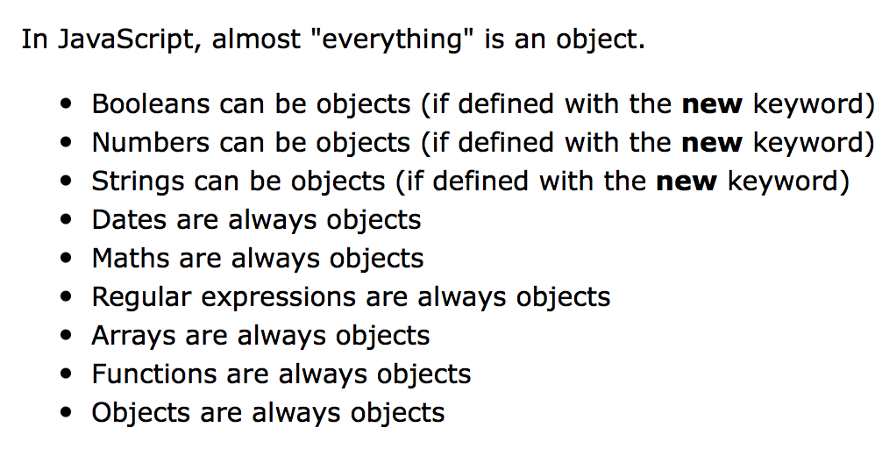
Object

Slide 5
Defining Object
key : value pairs
const student = { id: “123”,
name: “Moahmmed”.
courses: [“cs1”, “cs2”,”cs3”],
getAddr: function() {
return “khobar, ksa”;
}
};
Object can have any type of data: numbers, String, arrays, object …..

Slide 6
Property accessors
How to access name property ?
Dot Notation: student.name;
Bracket Notation: student[’name’];
const student = { id: “123”,
name: “Moahmmed”.
courses: [“cs1”, “cs2”,”cs3”],
getAddr: function() {
return “khobar, ksa”;
}
};

Slide 7
Property accessors (Function)
How to access getAddr property ?
Dot Notation: student.getAddr();
Bracket Notation: student[’getAddr’]();
const student = { id: “123”,
name: “Moahmmed”.
courses: [“cs1”, “cs2”,”cs3”],
getAddr: function() {
return “khobar, ksa”;
}
};

Slide 8
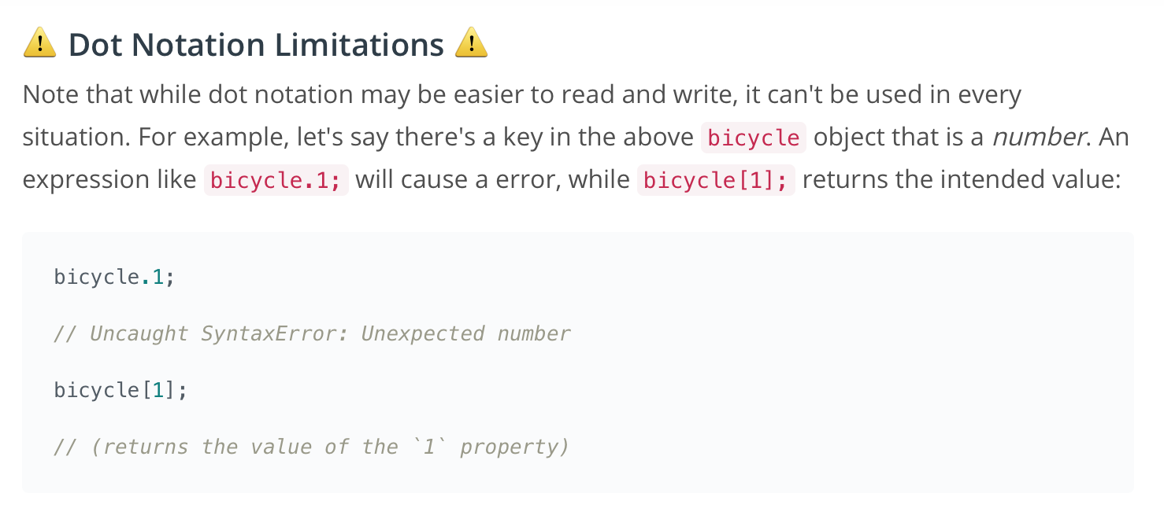
Dot Notation Limitation (1)

Slide 9
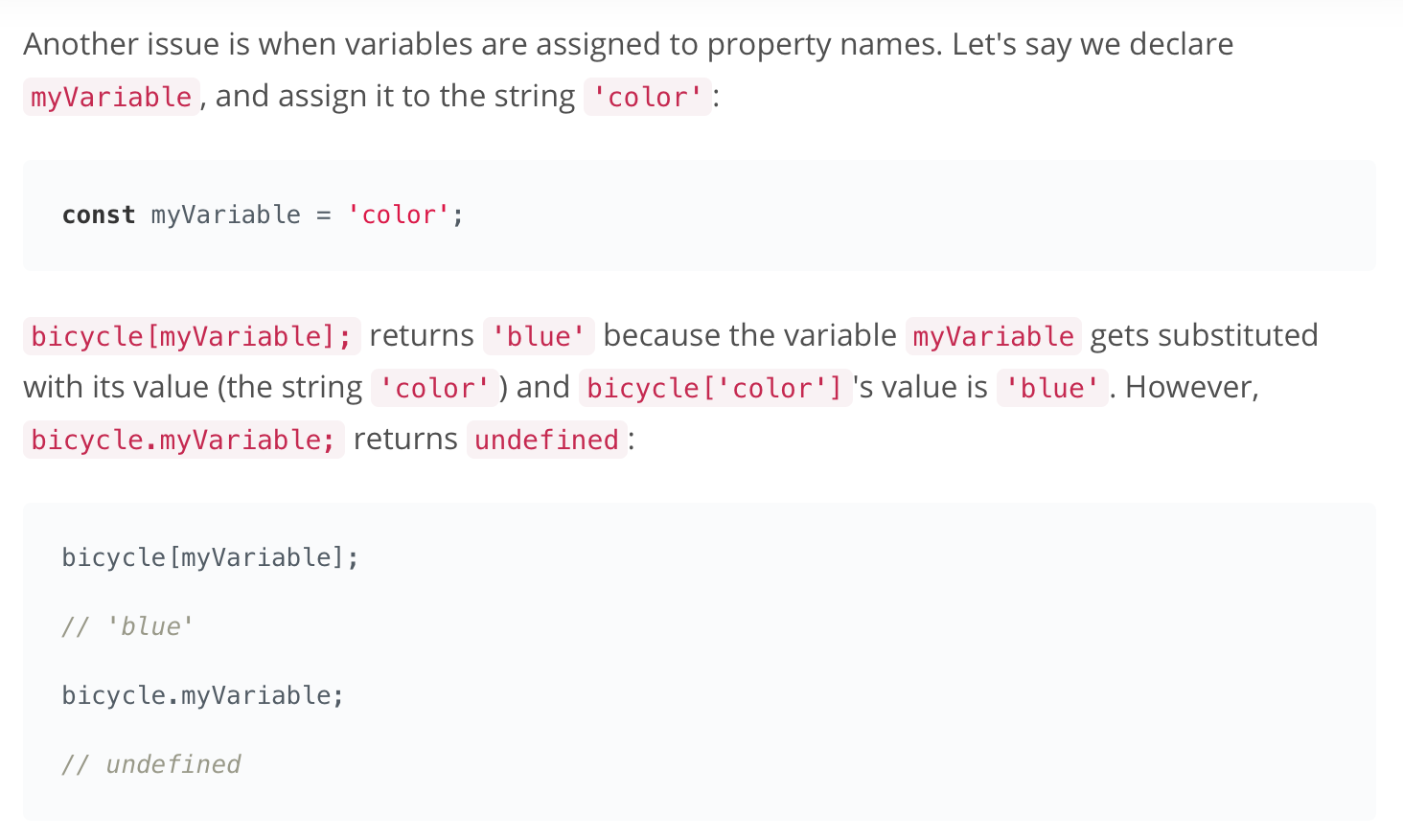
Dot Notation Limitation (2)

Slide 10
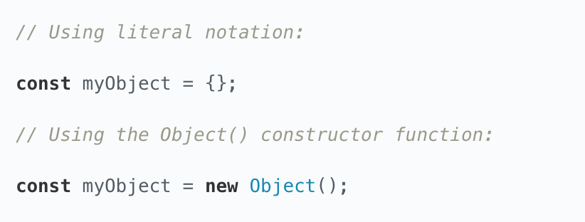
Creating Objects

Slide 11
This keywords
It refers to the owner of the function we are executing or to the object that function is a method of.
function doSomething() {
console.log(this);
}
doSomthing();
What is the output ?

Slide 12
Object.keys() and Object.values()
Let’s try: const student = { id: “123”,
name: “Moahmmed”.
courses: [“cs1”, “cs2”,”cs3”],
getAddr: function() {
return “khobar, ksa”;
}
};
Object.keys(student);
Object.values(student);

Slide 13
Function

Slide 14
First class function
This means that you can do with a function just about anything that you can do with other elements, such as numbers, strings, objects, arrays, etc.
JavaScript functions can:
Be stored in variables
Be returned from a function.
Be passed as arguments into another function.

Slide 15
Call back function
A function that is passed as an argument into another function is called a callback function.
function sum (num1,num2, other){
return num1 + num2 + other(num1,num2);
}
function add(first,second){
return first + second;
}
console.log(sum(2,3,add));

Slide 16
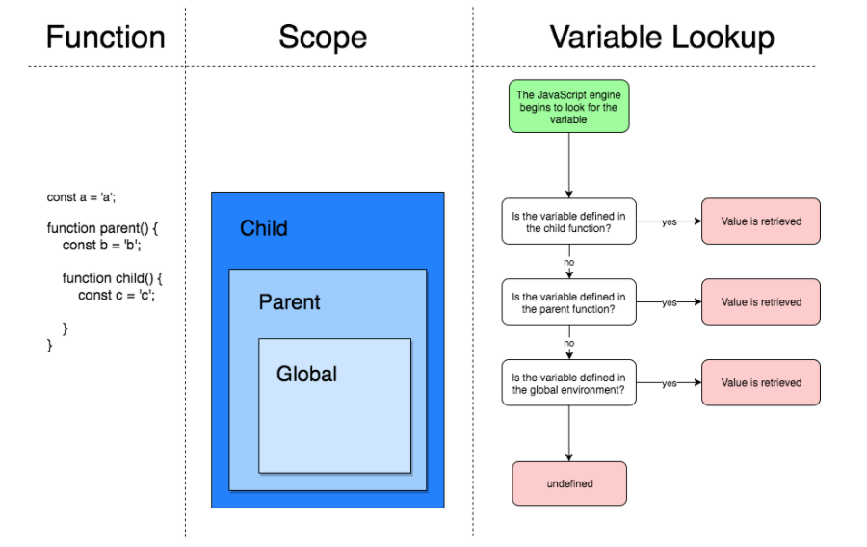
scopes

Slide 17
classes

Slide 18
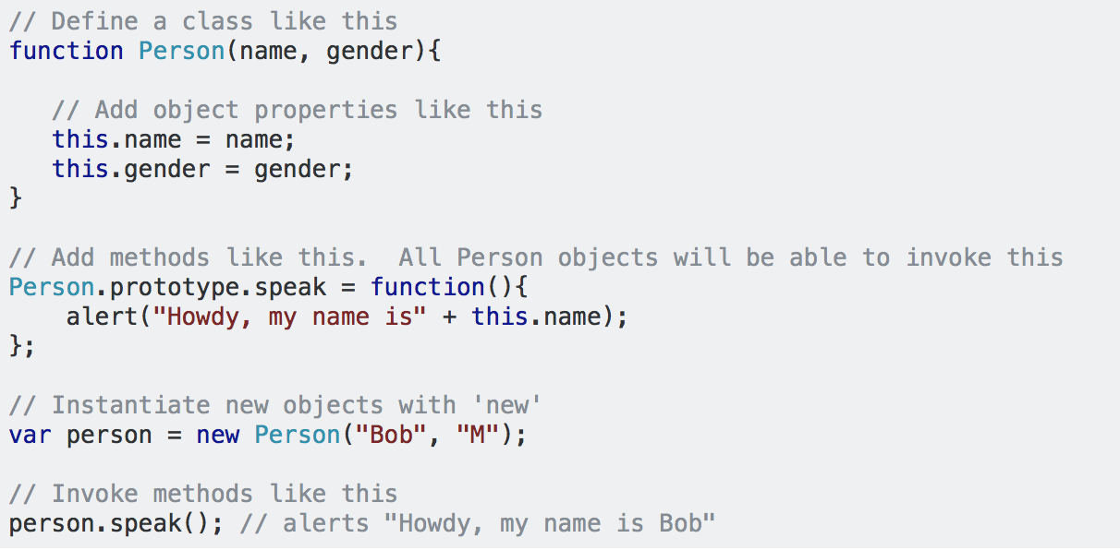
classes
Classes formalize the common JavaScript pattern of simulating class-like inheritance hierarchies using functions and prototypes.

Slide 19
Constructor
Objects of the same type are created by calling the constructor function with the new keyword.
Constructor Functions Can Have 0 Parameter or more.
let person2 = new Person(‘Bob’,’m’);

Slide 20
Instance Of
You can use instanceOf to check if the object is an instance of a specific class.
person2 instanceOf Person;
It will return a Boolean value

Slide 21
Prototypes
All JavaScript objects inherit properties and methods from a prototype.
With constructor, you can not add a new property to an existing object constructor:
function Person(first, last, age, eyecolor) { this.firstName = first; this.lastName = last; this.age = age; this.eyeColor = eyecolor; }
You can NOT do that !
Person.nationality = "English";

Slide 22
Prototypes
function Person(first, last, age, eyecolor) { this.firstName = first; this.lastName = last; this.age = age; this.eyeColor = eyecolor; }
You can add a new property by using “prototype”:
Person.prototype.nationality = "English";

Slide 23
Function es6

Slide 24
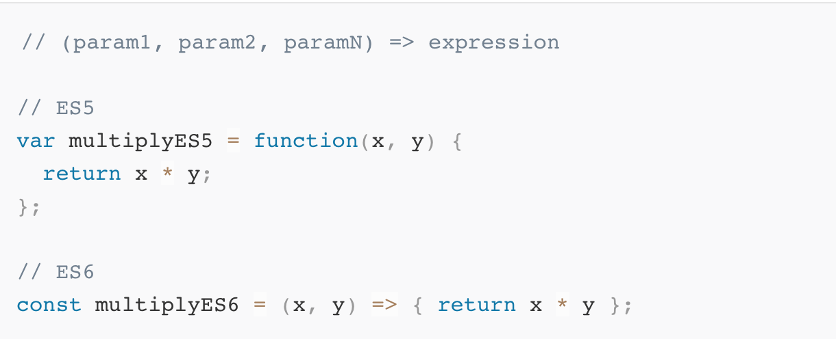
Arrow functions

Slide 25
Function to Arrow functions
remove the function keyword
remove the parentheses
remove the opening and closing curly braces
remove the return keyword
remove the semicolon
add an arrow ( => ) between the parameter list and the function body

Slide 26
Arrow functions and this
With regular functions, the value of this is set based on how the function is called. With arrow functions, the value of this is based on the function's surrounding context. In other words, the value of this inside an arrow function is the same as the value of this outside the function.

Slide 27
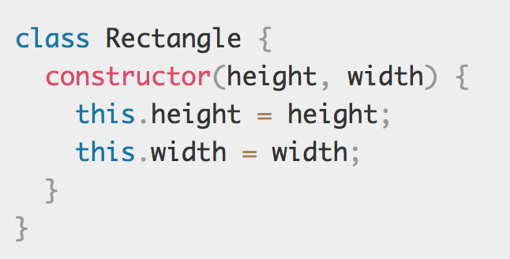
Es6 Class
One way to define a class is using a class declaration. To declare a class, you use the class keyword with the name of the class

Slide 28
Benefit of Class
1- Less setup
There's a lot less code that you need to write to create a function
2- Clearly defined constructor function
Inside the class definition, you can clearly specify the constructor function.
3- Everything's contained
All code that's needed for the class is contained in the class declaration. Instead of having the constructor function in one place, then adding methods to the prototype one-by-one, you can do everything all at once!

Slide 29
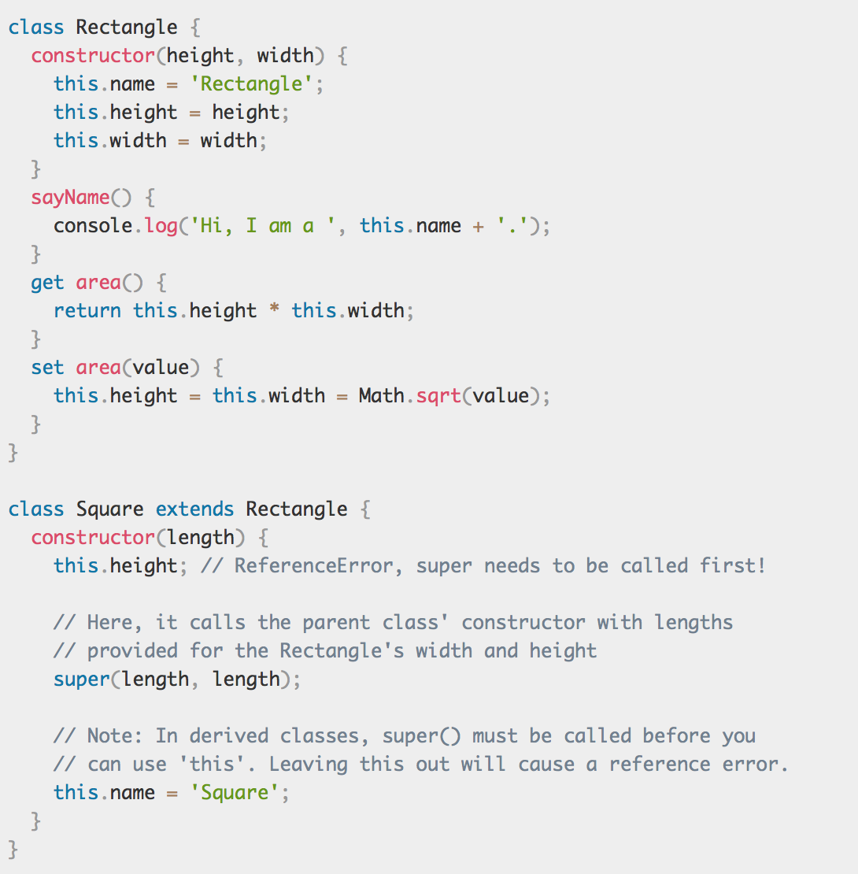
Subclasses with ES6

Slide 30
Classic arcade games

Slide 31

Remember that we are here to help you
All you have to do is ASK!
Thank you for Attending

